Slide 1
Project 0: Arcade Java Console Application
Revature x Cognizant
Suyesh Shrestha
December 23rd, 2025

Slide 2
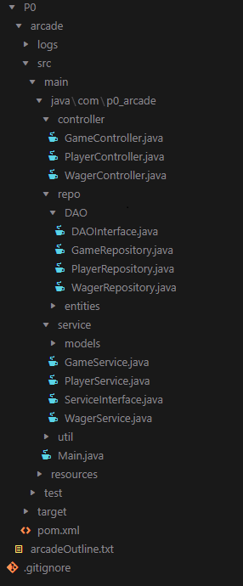
Project Structure
The Arcade
Users are able to play games such as Coin Flip and Rock, Paper, and Scissors and wager points to either win or lose. Points and users are tracked through the database.
Repository
Service
Controller
Main
Repository Layer communicates with the Postgres Database
The Repository Layer uses JDBC API to communicate with the database in order to achieve persistence within the application.
Service Layer handles business logic
The Service Layer uses CRUD operations to handle entities from the DAO layer.
Controller Layer handles User I/O
Uses service functions to handle input and output for game and player handling.
Main Method calls the Controller Layer functions and objects
Main method creates console menu UI and calls the Game controller depending on user input.
Notes:
A quick overview of the application, users are able to play the classic games Coin Flip and Rock Paper Scissors. Each user has a number points associated with their Player and is able to wager those points everytime they play a game and go against the Arcade. Each of the wagers and points are tracked for each of the Players in the database.
For my project structure, I have a repository layer that communicates with the PostgreSQL database using the JDBC API; a service layer that handles the business logic of the application and handles all the CRUD operations for the entities from the REPO layer; and a controller layer that handles input and output for game and player interactions. Finally, there is the Main function that runs the whole thing.

Slide 3
Entities
Player
Represents each user that enters the Arcade.
Wager
Represents each time a Player plays a game and the amount of points they are playing with
Game
Coin Flip and Rock Paper Scissors. These entities are static cannot be edited.
id | integer PRIMARY KEY
name | varChar(100)
points | integer
id | integer PRIMARY KEY
player_id | integer FOREIGN KEY
game_id | integer FOREIGN KEY
points | integer
id | integer PRIMARY KEY
name | varChar(100)
description | text
min_wager | integer
multiplier | numeric(4,2)
Notes:
It’s in 1NF: columns are atomic (no lists/arrays in a single column), rows are unique.
It’s in 2NF: every non-key column depends on the whole key (mostly relevant for composite keys).
It’s in 3NF: no transitive dependencies — non-key columns depend only on the primary key, not on other non-key columns.
In order to achieve a many-to-many relationship, I have many players playing many games

Slide 4
Project Demo

Slide 5

Github Public Repo + Questions
https://github.com/suy3sh/Revature_Training
(Inside P0 folder)

